Slide 1
Cloud design Pattern
Huanmin wu, Inspired by Jonas Boner, twitter:@jboner

Slide 2
Fallacies of Distributed Computing Dr. Dobb's Portal www.ddj.com/dept/architect
The Network is reliable
Latency is zero
Bandwidth is infinite
The network is secure
Topology doesn’t change
There is one administrator
Transport cost is zero
The network is homogeneous

Slide 3
Performance numbers you need to know
Operation | Time (nsec)
L1 cache reference | 0.5
Branch mispredict | 5
L2 cache reference | 7
Mutex lock/unlock | 25
Main memory reference | 100
Compress 1KB bytes with Zippy | 3,000
Send 2K bytes over 1 Gbps network | 20,000
Read 1MB sequentially from memory | 250,000
Roundtrip within same datacenter | 500,000
Disk seek | 10,000,000
Read 1MB sequentially from disk | 20,000,000
Send packet CA -> Netherlands -> CA | 150,000,000

Slide 4
Performance numbers you need to know
Operation | Time (nsec)
System call overhead | 400
Context switch between processes | 3000
fork() (statically-linked binary) | 70,000
fork() (dynamically-linked binary) | 160,000

Slide 5
AVAILABILITY
SCALABILITY
STABILITY
Replication
Master-Slave
Master-Master
Fail-over
State
Distributed Caching
Data Grid
Data Storage: NoSQL, RDBMS
HTTP caching
CAP Theorem
Concurrency
Partitioning / Replication
Behavior
Compute Grid
Event driven architecture
Load balancing
Parallel computing
Circuit Breaker
Timeout
Crash Supervisor
Bulk heads
Steady State/clean resource
Throttling

Slide 6


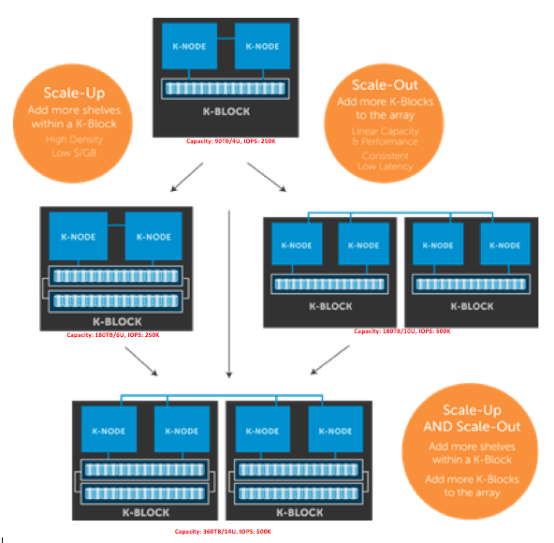
Scale UP or Scale OUT

Slide 7
General Recommendations
Immutability as the default
Stateless vs Stateful
Referential Transparency
Lazy action
Asynchronous

Slide 8
Scalability Trade-offs
Performance vs Scalability
Your system is fast for a single user but slow under heavy load
Latency vs Throughput
Maximum throughput with acceptable latency
Availability vs Consistency
CAP theorem

Slide 9
CAP Theorem
You can only pick 2 at a given point in time
Consistency, Availability, Partition tolerance
In a centralized system (RDBMS), where no network partitions.
Atomic, Consistent, Isolated, Durable
In a distributed system where we have network partitions, e.g. P in CAP.
So you can only pick one
Availability, Consistency

Slide 10
Availability Pattern

Slide 11
Availability Patterns
Failover
Replication
Master-Slave
Master-Master
Tree Replication
Buddy Replication

Slide 12
How do we calculate availability?

Slide 13
Fail-over and Fail-back

Slide 14
Network Fail-Over

Slide 15
Replication

Slide 16
Replication
Master-Slave Replication
Master-Master Replication
Tree Replication
Buddy Replication

Slide 17
Master-Slave Replication

Slide 18
Master-Master Replication

Slide 19
Buddy replication

Slide 20
Buddy replication

Slide 21
Scalability Patterns: state

Slide 22
Scalability Patterns : State
Partitioning
Make service local
RDBMS Sharding
HTTP Caching
NOSQL
Distributed Caching
Data Grid
Concurrency

Slide 23
Partitioning

Slide 24
Compute partitioning
Performance and scalability
Availability
Deployment and updating
Security
Resource utilization
Hosting environment
Background tasks
Management and Maintenance
Runtime cost
Dependencies
Inter-process Communication

Slide 25
Data partitioning
Horizontal Partitioning (Sharding)
Vertical Partitioning (Split fields)
Functional Partitioning

Slide 26
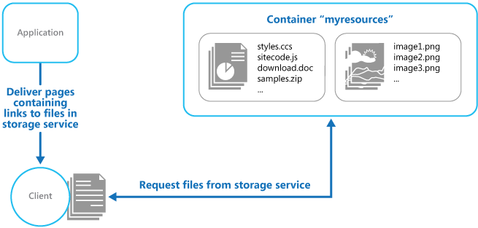
Static content Hosting

Slide 27
HTTP Caching CDN, Akamai

Slide 28
HTTP Caching
Reverse Proxy
Varnish
Squid
Rack-cache
Pound
Ngnix
Apache mod_proxy
Traffic Server

Slide 29
Generate Static Content
Precompute content
Homegrown + cron or Quartz
Spring Batch
Gearman
Hadoop
Google Data Protocol
Amazon Elastic MapReduce

Slide 30
Http Caching
First request
Subsequent request

Slide 31
DATA STORE

Slide 32
Data Storage
Relation Databases (RDBMS)
NOSQL Databases

Slide 33
How to scale out RDBMS

Slide 34
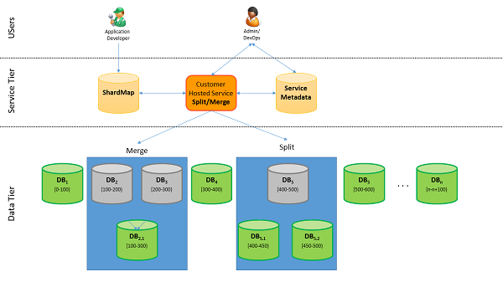
RDBMS Sharding

Slide 35
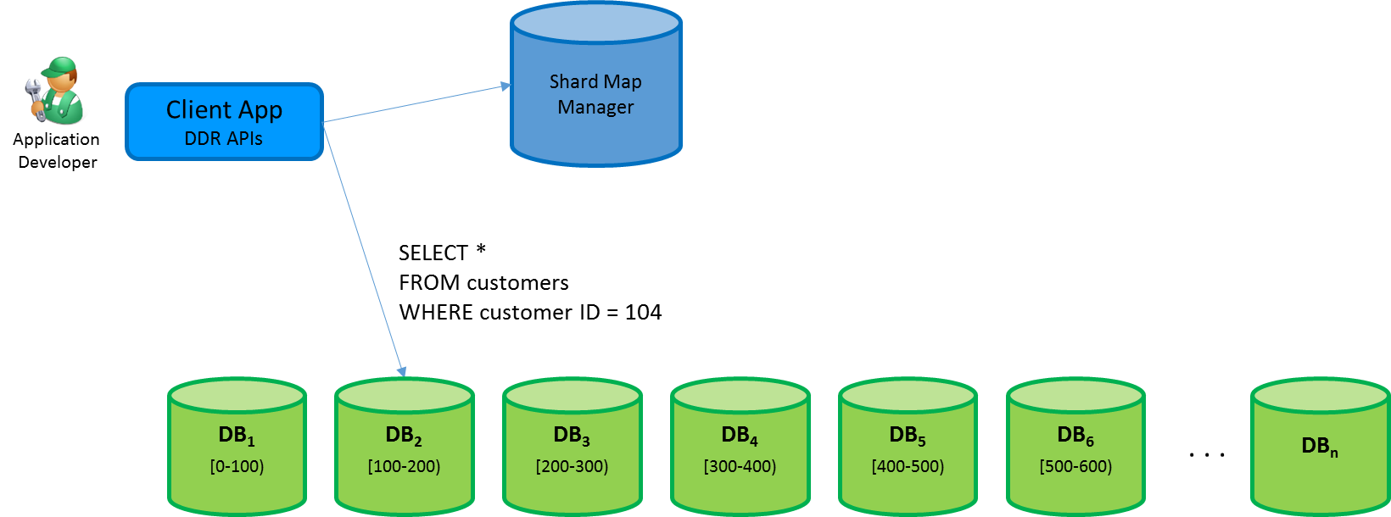
RDBMS Sharding

Slide 36
Sharding strategy
Strategy | Advantages | Considerations
Lookup | More control on the shards Reduces the impact when rebalancing data. | Looking up shard locations is additional overhead.
Range | Easy to implement. Works well with range queries. Easier data management. e.g. schedule maintenance based on time zone. | not optimal balancing between shards.
Hash | Better chance of a more even data and load distribution. No need to maintain a map. | Computing the hash is overhead. Rebalancing shards is difficult.

Slide 37
ORM + rich domain model anti-pattern
Attempt:
Read an object from DB
Result
You sit with your whole database in your lap.

Slide 38
Do we really need a RDBMS?
When is a RDBMS not good enough?
Scaling reads to a RDBMS is hard
Scaling writes to a RDBMS is almost impossible
Think about your data
When you need ACID?
When is eventually consistent a better fit?
Different kinds of data has different needs

Slide 39
ACID or Base?
Who support ACID?
Relational databases (MySQL, Postgres, Oracle, SQL Server)
Object DBs (Gemstone, db4o)
Clustering products (Coherence, Terracotta)
Most caching products (MemSQL, ehcache)
Who is base?
Distributed databases
Cassandra, Riak, Voldemort, Dynomite, Simple DB, etc

Slide 40
NOSQL (Not Only SQL)

Slide 41
TYPES OF NOSQL STORES
Key-Value databases (Voldemort, Dynamo)
Column databases (Cassandra, Vertica, Sybase IQ)
Document databases (MongoDB, Counch DB, Cosmos DB/DocDB)
Graph databases (Neo4j, AllegroGraph)
Data structure databases (Redis, Hazelcast)

Slide 42
NOSQL in the wild
Google: Bigtable, Spanner
Amazon: Dynamo, Simple DB
Yahoo: Hbase
Facebook: Cassandra
Linkedin: Voldemort

Slide 43
NOSQL Common Features
Distributed Hash Tables (DHT)
Scalable
Partitioned
Fault-tolerant
Decentralized
Peer to peer
Popularized
Node Ring, Consistent Hashing

Slide 44
NOSQL Common characteristics
Key value store
Run on large number of commodity machines
Data are partitioned and replicated among these machines
Relax the data consistency requirement. (because the CAP theorem proves that you cannot get Consistency, Availability and Partitioning at the the same time)

Slide 45
API model
The underlying data model can be considered as a large Hashtable (key/value store).
The basic form of API access is
get(key) -- Extract the value given a key
put(key, value) -- Create or Update the value given its key
delete(key) -- Remove the key and its associated value
More advance form of API allows to execute user defined function
execute(key, operation, parameters)
-- Invoke an operation to the value (given its key) which is a special data structure (e.g. List, Set, Map . ... etc).
mapreduce(keyList, mapFunc, reduceFunc)
-- Invoke a map/reduce function across a key range.

Slide 46
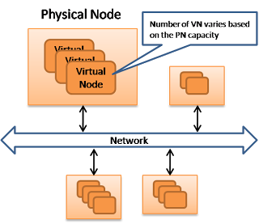
Machine layout

Slide 47
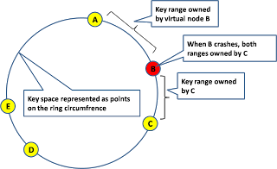
Data partitioning (consistency HASHing)

Slide 48
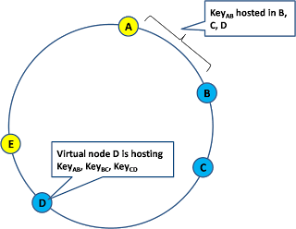
Data replication

Slide 49
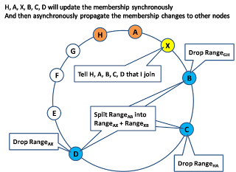
Membership changes A new node joins the network
1. The joining node announce its presence and its id to some well known VNs or just broadcast)
2. All the neighbors (left and right side) will adjust the change of key ownership as well as the change of replica memberships. This is typically done synchronously.
3. The joining node starts to bulk copy data from its neighbor in parallel asynchronously.
4. The membership change is asynchronously propagate to the other nodes.

Slide 50
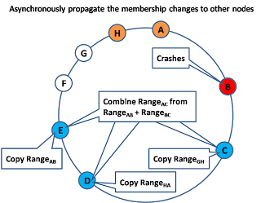
Membership changes When an existing node leaves the network (e.g. crash)
1. The crashed node no longer respond to gossip message so its neighbors knows about it.
2. The neighbor will update the membership changes and copy data asynchronously.

Slide 51
Vector Clock
Vector Clock is a timestamp mechanism such that we can reason about causal relationship between updates. First of all, each replica keeps vector clock. Lets say replica i has its clock Vi. Vi[i] is the logical clock which if every replica follows certain rules to update its vector clock. Whenever an internal operation happens at replica i, it will advance its clock Vi[i]
Whenever replica i send a message to replica j, it will first advance its clock Vi[i] and attach its vector clock Vi to the message
Whenever replica j receive a message from replica i, it will first advance its clock Vj[j] and then merge its clock with the clock Vm attached in the message. ie: Vj[k] = max(Vj[k], Vm[k])

Slide 52
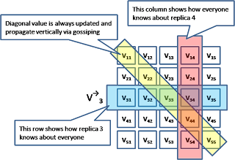
Vector Clock

Slide 53
Gossip (State Transfer Model)
In a state transfer model, each replica maintain a vector clock as well as a state version tree where each state is neither > or < among each other (based on vector clock comparison). In other words, the state version tree contains all the conflicting updates.

Slide 54
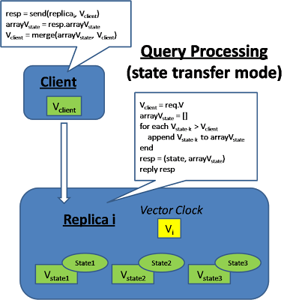
Gossip State transfer mode: Query
At query time, the client will attach its vector clock and the replica will send back a subset of the state tree which precedes the client's vector clock (this will provide monotonic read consistency). The client will then advance its vector clock by merging all the versions. This means the client is responsible to resolve the conflict of all these versions because when the client sends the update later, its vector clock will precede all these versions.

Slide 55
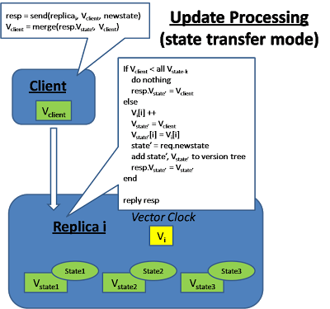
Gossip State transfer mode: update
At update, the client will send its vector clock and the replica will check whether the client state precedes any of its existing version, if so, it will throw away the client's update.

Slide 56
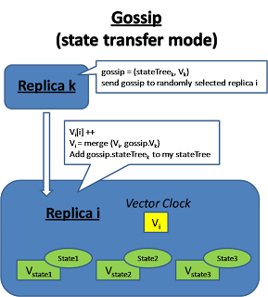
Gossip State transfer mode: gossip among each other
Replicas also gossip among each other in the background and try to merge their version tree together

Slide 57
Gossip (Operation Transfer Model)
In an operation transfer approach, the sequence of applying the operations is very important. At the minimum causal order need to be maintained. Because of the ordering issue, each replica has to defer executing the operation until all the preceding operations has been executed. Therefore replicas save the operation request to a log file and exchange the log among each other and consolidate these operation logs to figure out the right sequence to apply the operations to their local store in an appropriate order. "Causal order" means every replica will apply changes to the "causes" before apply changes to the "effect". "Total order" requires that every replica applies the operation in the same sequence. In this model, each replica keeps a list of vector clock, Vi is the vector clock the replica itself and Vj is the vector clock when replica i receive replica j's gossip message. There is also a V-state that represent the vector clock of the last updated state.

Slide 58
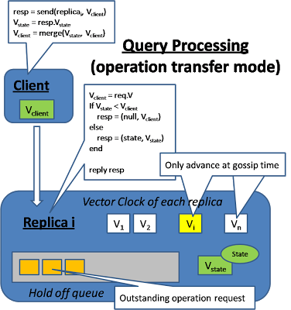
Gossip operation transfer mode: Query
When a query is submitted by the client, it will also send along its vector clock which reflect the client's view of the world. The replica will check if it has a view of the state that is later than the client's view.

Slide 59
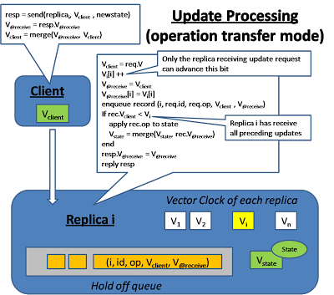
Gossip operation transfer mode: update
When an update operation is received, the replica will buffer the update operation until it can be applied to the local state. Every submitted operation will be tag with 2 timestamp, V-client indicates the client's view when he is making the update request. V-@receive is the replica's view when it receives the submission. This update operation request will be sitting in the queue until the replica has received all the other updates that this one depends on. This condition is reflected in the vector clock Vi when it is larger than V-client

Slide 60
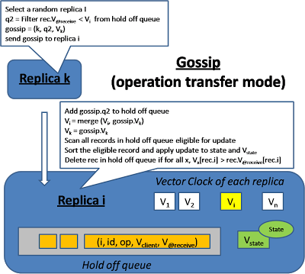
Gossip operation transfer mode: exchange
On the background, different replicas exchange their log for the queued updates and update each other's vector clock. After the log exchange, each replica will check whether certain operation can be applied (when all the dependent operation has been received) and apply them accordingly. Notice that it is possible that multiple operations are ready for applying at the same time, the replica will sort these operation in causal order (by using the Vector clock comparison) and apply them in the right order.

Slide 61
Gossip (concurrent update problem)
The concurrent update problem at different replica can also happen. Which means there can be multiple valid sequences of operation. In order for different replica to apply concurrent update in the same order, we need a total ordering mechanism. One approach is whoever do the update first acquire a monotonic sequence number and late comers follow the sequence. On the other hand, if the operation itself is commutative, then the order to apply the operations doesn't matter After applying the update, the update operation cannot be immediately removed from the queue because the update may not be fully exchange to every replica yet. We continuously check the Vector clock of each replicas after log exchange and after we confirm than everyone has receive this update, then we'll remove it from the queue.

Slide 62
Gossip Summary
Each client request has the version of server replicas which it believes, server will throw away the updates with lower versions.
The response may contain a list of change sets, and client has to resolve the conflict.
The update operations on server replicas will be buffered until all the dependent operations are received.
Each replica will exchange the states (for themselves or others) with their neighbors, which is called as gossip.

Slide 63
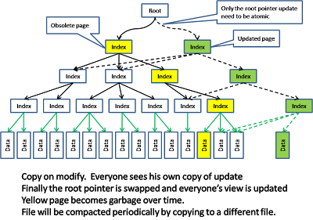
Storage implementation copy-on-modified
CouchDB has a MVCC model that uses a copy-on-modified approach. Any update will cause a private copy being made which in turn cause the index also need to be modified and causing the a private copy of the index as well, all the way up to the root pointer.

Slide 64
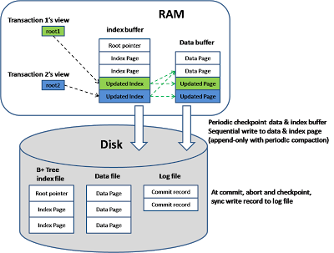
Storage implementation copy-on-modified
Notice that the update happens in an append-only mode where the modified data is appended to the file and the old data becomes garbage. Periodic garbage collection is done to compact the data. Here is how the model is implemented in memory and disks

Slide 65
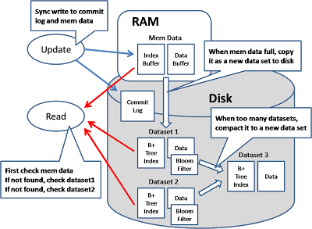
Storage implementation google-big-table
In Google BigTable model, the data is broken down into multiple generations and the memory is use to hold the newest generation. Any query will search the mem data as well as all the data sets on disks and merge all the return results. Fast detection of whether a generation contains a key can be done by checking a bloom filter.
When update happens, both the mem data and the commit log will be written so that if the machine crashes before the mem data flush to disk, it can be recovered from the commit log.

Slide 66
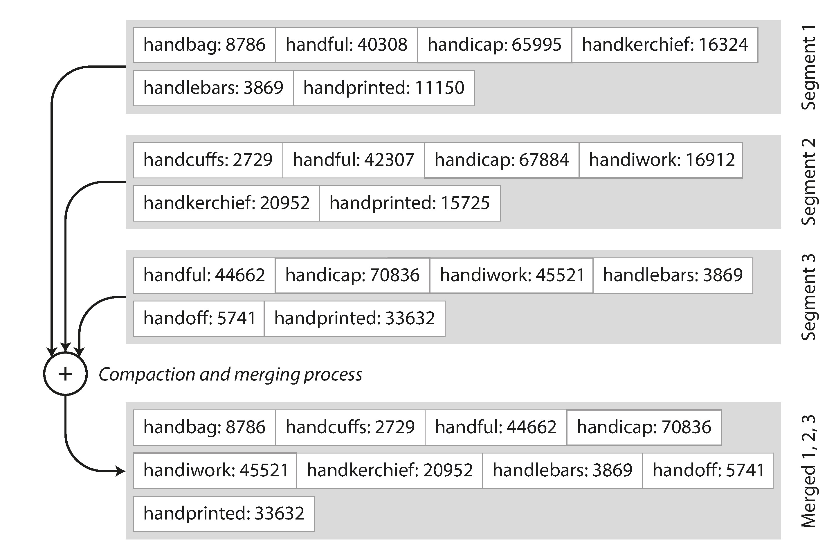
Sorted String Tables(SSTables)

Slide 67
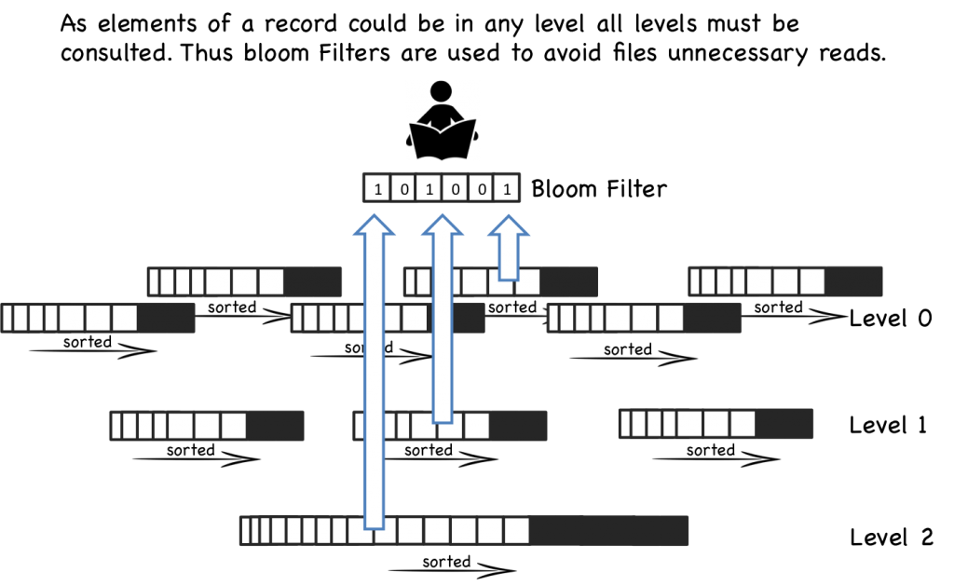
Data can be at any level of LSM tree

Slide 68
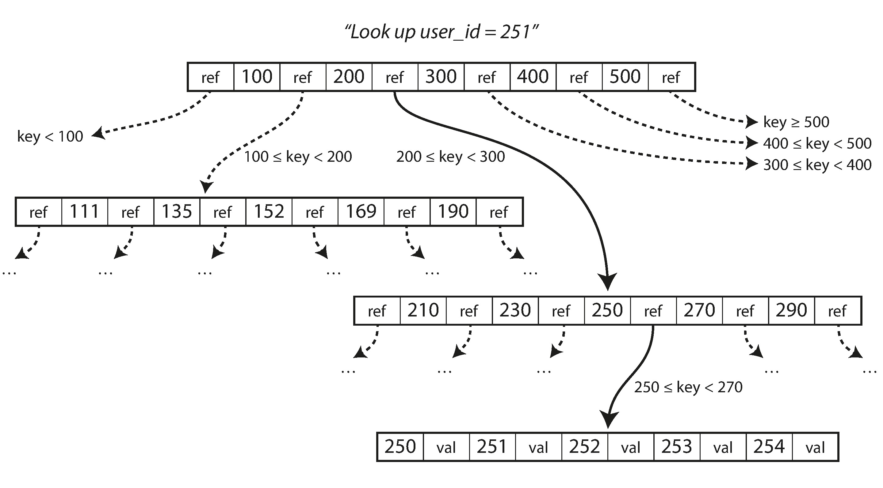
B-Trees

Slide 69
Big Table
“How can we build a DB on top of Google File System?”
Paper: Big table: A distributed storage system for structured data, 2006
Rich data model, structured storage
Clone:
HBase, Hypertable, Neptune

Slide 70
DYNAMO
“How can we build a distributed hash table for the data center?”
Paper: Dynamo: Amazon’s highly available key-value store, 2007
Focus: partitioning, replication and availability
Eventually Consistent
Clone:
Voldemort, Dynomite

Slide 71
Transactions and Data Consistency

Slide 72
Client-side consistency
Strict Consistency (one copy serializability):
This provides the semantics as if there is only one copy of data. Any update is observed instantaneously.
Read your write consistency:
The allows the client to see his own update immediately (and the client can switch server between requests), but not the updates made by other clients
Session consistency:
Provide the read-your-write consistency only when the client is issuing the request under the same session scope (which is usually bind to the same server)
Monotonic Read Consistency:
This provide the time monotonicity guarantee that the client will only see more updated version of the data in future requests.
Eventual Consistency:
This provides the weakness form of guarantee. The client can see an inconsistent view as the update are in progress. This model works when concurrent access of the same data is very unlikely, and the client need to wait for some time if he needs to see his previous update.

Slide 73
Client-side consistency
What is consistency
Example: money transfer from A to B, subtract from A, add to B. What if something happen in between, for example machine crash
Weak consistency
Strong consistency
Eventually consistent
Never consistent

Slide 74
Consistency Pattern
Weak consistency
Eventual Consistency
Strong consistency
After a write, reads may or may not see it.
Best effort
“Message in a bottle”
AppEngine : MemCache
VoIP, live online video
Real time multiplayer game
After a write, reads will eventually see it.
AppEngine: mail
Search engine indexing
DNS, SMTP, Snail mail
Amazon S3, Simple DB
After a write, read will see it
AppEngine: database
File system
RDBMS
Azure tables

Slide 75
Client-side Eventual Consistency levels
Casual consistency
Read-your-writes consistency (important)
Session consistency
Monotonic read consistency (important)
Monotonic write consistency

Slide 76
Server-side consistency
N = the number of nodes that store replicas of the data
W = the number of replicas that need to acknowledge the receipt of the update before the update completes
R = the number of replicas that are contacted when a data object is accessed through a read operation
W + R > N strong consistency
W + R <= N eventual consistency

Slide 77
Backup
Make a copy
Sledgehammer
Weak consistency
Usually no transactions
Datastore: early internal launch

Slide 78
Master / Slave Replication
Usually Asynchronous
Good for throughput, latency
Most RDBMS
MySQL binary log
Weak / eventual consistency
Granularity matters
Data store: current

Slide 79
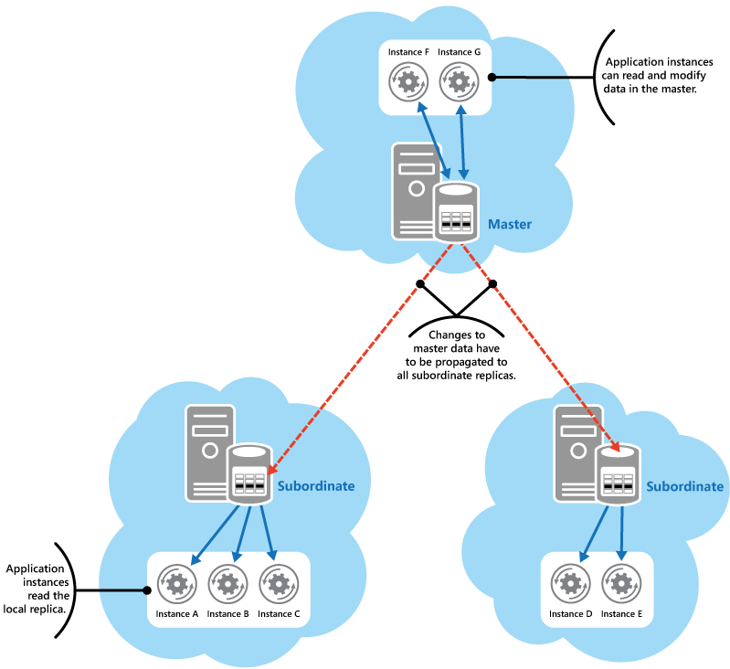
Master-Slave Replication

Slide 80
Master / Master Replication
Umbrella term for merging concurrent writes
Asynchronous, eventual consistency
Need serialization protocol
e.g. timestamp oracle: monotonically increasing timestamps
Either SPOF with master election...
...or distributed consensus protocol
No global transactions!
Data store: no strong consistency

Slide 81
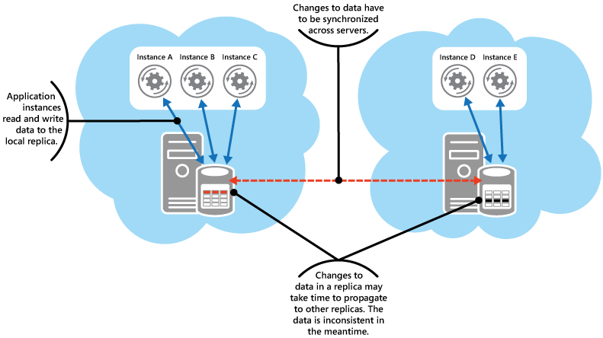
Master-Master Replicaton

Slide 82
Two Phase Commitment
Semi-distributed consensus protocol
deterministic coordinator
1: propose, 2: vote, 3: commit/abort
Heavyweight, synchronous, high latency
3PC buys async with extra round trip
Data store: poor throughput

Slide 83
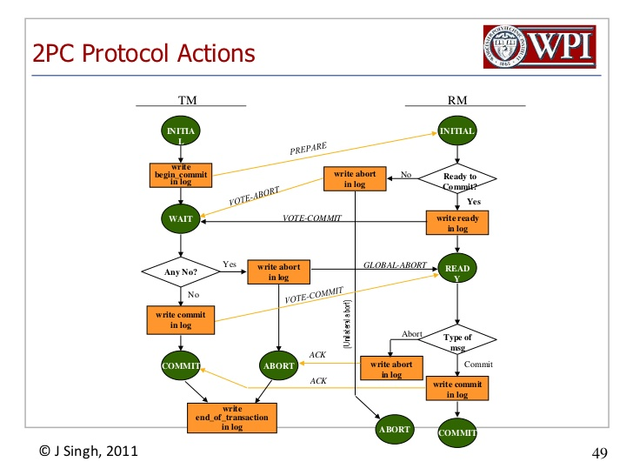
Two Phase Commitment

Slide 84
PAXOS
Fully distributed consensus protocol
"Either Paxos, or Paxos with cruft, or broken"
Mike Burrows
Majority writes; survives minority failure
Protocol similar to 2PC/3PC
Lighter, but still high latency
Coordinate moving state
...usually via lock server
Apps: Memcache
Offline processing

Slide 85
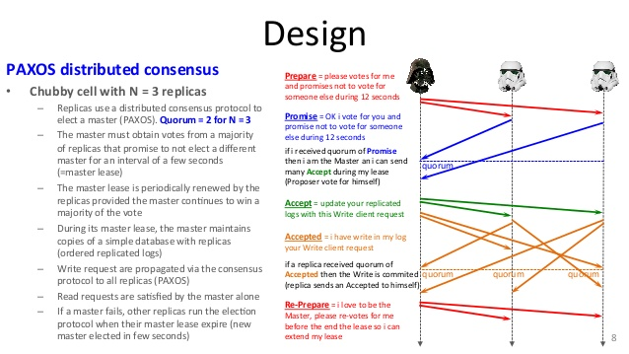
PAXOS protocol
Multiple proposers are allowed, but only highest version will be accepted.

Slide 86
Consistency summary
 | Backups | M / S | M / M | 2PC | Paxos
Consistency | Weak | Eventual |  | Strong
Transactions | No | Full | Local | Full
Latency | Low |  |  | High
Throughput | High |  |  | Low | Medium
Data loss | Lots | Some |  | None
Failover | Down | Read only | Read/write
 | Backups | M/S | MM | 2PC | Paxos
Consistency
Transactions
Latency
Throughput
Data loss
Failover
 | Backups | M/S | MM | 2PC | Paxos
Consistency | Weak
Transactions | No
Latency | Low
Throughput | High
Data loss | Lots
Failover | Down
 | Backups | M/S | MM | 2PC | Paxos
Consistency | Weak | Eventual
Transactions | No | Full
Latency | Low
Throughput | High
Data loss | Lots | Some
Failover | Down | Read only
 | Backups | M/S | MM | 2PC | Paxos
Consistency | Weak | Eventual
Transactions | No | Full | Local
Latency | Low
Throughput | High
Data loss | Lots | Some
Failover | Down | Read only | Read/write

Slide 87
Application Pattern for transaction consistency

Slide 88
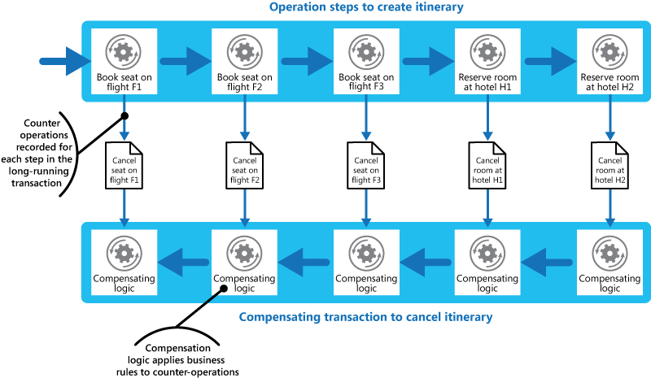
Compensating Transaction

Slide 89
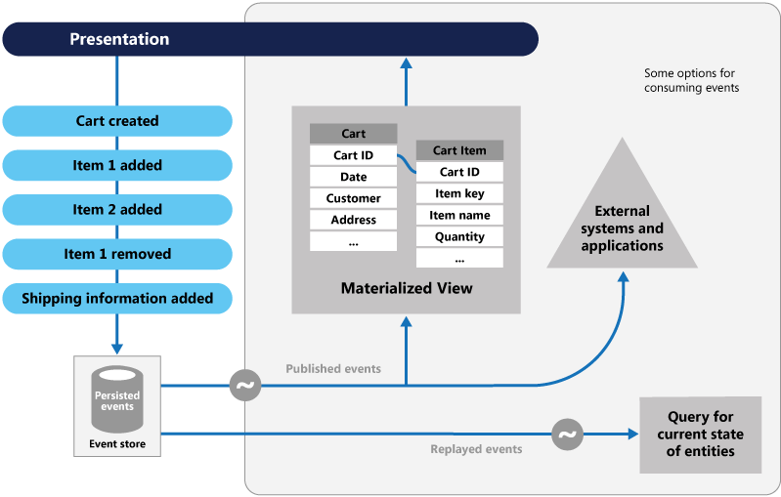
Event Sourcing pattern

Slide 90
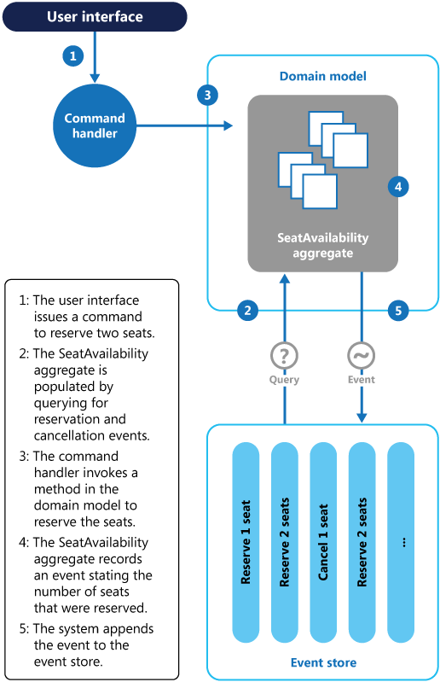
Example: Seat Reservation

Slide 91
Distributed Caching

Slide 92
Distributed Caching
Write-through
Write-behind
Eviction Policies
Replication
Peer-To-Peer (P2P)

Slide 93
Write-through and Write behind
Write-through
Write-behind
user
user
3. Return to user
3. Return to user
1. Write to cache
1. Write to cache
queue
cache
cache
2. Add event to queue
2. Store in DB
DB
4. Asynchronously: select and execute event
Event processor
DB

Slide 94
Eviction policies
TTL (time to live)
Bounded FIFO (first in first out)
Bounded LIFO (last in first out)
Explicit cache invalidation
If it is not atomic when data is changed, there is some inherited consistency issue.

Slide 95
Peer-To-Peer
Decentralized
No “special” or “blessed” nodes
Node can join and leave as they please.

Slide 96
Distributed Caching products
EHCache
JBoss Cache
OSCache
Memcached

Slide 97
Memcached
Very fast
Simple
Key – Value (string –>binary)
Clients for most languages
Distributed
Not replicated

Slide 98
Shared Cache Service

Slide 99
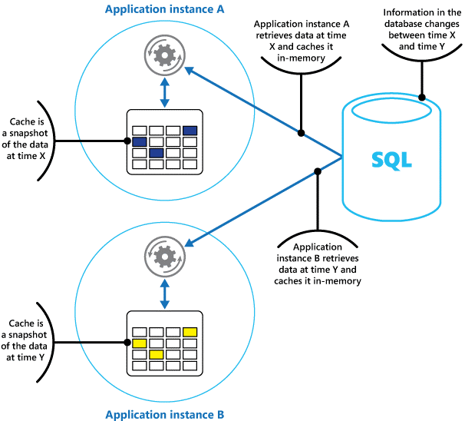
Private Caching

Slide 100
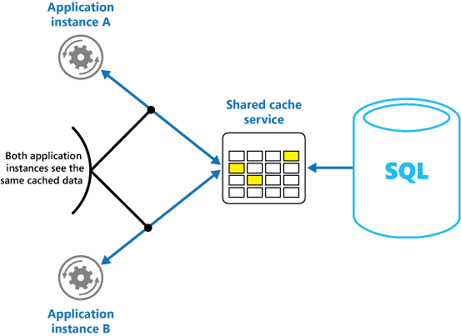
Shared Caching

Slide 101
Data Grids / Clustering

Slide 102
Data Grids / clustering Parallel data storage
Data Replication
Data partition
Continuous availability
Data invalidation
Fail-over
C+P in CAP

Slide 103
Data Grids / clustering Products
Coherence
Terracotta
GigaSpace
GemStone
Tibco Active Matrix
Hazelcast

Slide 104
Concurrency

Slide 105
Concurrency
Shared-State Concurrency
Message-Passing Concurrency
Dataflow Concurrency
Software Transactional Memory

Slide 106
Shared State Concurrency

Slide 107
Shared State Concurrency
Everyone can access anything anytime.
Totally indeterministic
Introduce determinism at well defined places
Using locks…
Problems with locks
Locks do not compose, take too many or too few locks, taking wrong locks, taking locks in the wrong order, Every recovery is hard.

Slide 108
Shared State Concurrency
Please use java.util.concurrent.*
ConcurrentHashMap
BlockingQueue
ConcurrentQueue
ExecutorService
ReentrantReadWriteLock
CountDownLatch
ParallelArray
And much more

Slide 109
Messaging – Passing Concurrency

Slide 110
Actors
Originates in 1973 paper by Carl Hewitt
Implemented in Erlang, Occam, Oz
Encapsulates state and behavior
Closer to the definition of OO than classes

Slide 111
Actors
Share NOTHING
Isolated lightweight process
Communicates through messages
Asynchronous and non-blocking
No shared state
… hence, nothing to synchronize
Each actor has a mailbox (message queue)

Slide 112
Actors
Easier to reason about
Raised abstraction level
Easier to avoid
Race conditions
Deadlocks
Starvation
Live Locks

Slide 113
Actor libs for the JVM
Akka (Java / Scala)
Scalaz actors (Scala)
Lift Actors (Scala)
Scalar Actors (Scala)
Kilim (Java)
Jetlang (Java)
Actor’s Guild (Java)
Actorom (Java)
Functional Java (Java)
GPars (Groovy)

Slide 114
Data flow Concurrency

Slide 115
DATA flow Concurrency
Declarative
No observable, non-determinism
Data driven – threads block until data is available.
On demand – lazy.
No difference between:
Concurrent & Sequential code
Limitations: Can’t have side-effects.

Slide 116
STM: Software Transactional Memory

Slide 117
STM: overview
See the memory (heap and stack) as a transactional dataset
Similar to a database
begin / commit / rollback or abort
Transactions are retried automatically upon collision
Rolls back the memory on abort

Slide 118
STM: overview
atomic {
…
atomic {
…
}
}
Transactions can nest
Transactions compose
All operations in scope of a transaction: need to be idempotent.

Slide 119
STM libs for the JVM
Akka (Java / Scala)
Multiverse (Java)
Clojure STM (Clojure)
CCSTM (Scala)
Deuce STM (Java)

Slide 120
Scalability Patterns: behavior

Slide 121
Scalability patterns: Behavior
Event driven Architecture
Compute Grids
Load-Balancing
Parallel Computing

Slide 122
Event Driven Architecture
“Four years from now, ‘mere mortals’ will begin to adopt an event-driven architecture (EDA) for the sort of complex event processing that has been attempted only by software gurus [in past].”
-- Roy Schulte (Gartner), 2003

Slide 123
Event Driven architecture
Domain Events
Event Sourcing
Command and Query Responsibility Segregation (CQRS) pattern
Event Stream Processing
Messaging
Enterprise Service Bus
Actors
Enterprise Integration Architecture (EIA)

Slide 124
Domain Events
“It is really become clear to me in the last couple of years that we need a new building block and that is the Domain Events”
“Domain Events represent the state of entities at a given time when an important event occurred and decouple subsystems with event streams. Domain Events give us clearer, more expressive models in those cases.”
-- Eric Evans, 2009

Slide 125
Domain Events
“State transitions are an important part of our problem space and should be modeled within our domain.”
-- Greg Young, 2008

Slide 126
Event Sourcing
Every state change is materialized in an Event
All Events are sent to an EventProcessor
EventProcessor stores all events in an Event Log
System can be reset and Event Log replayed
No need for ORM, just persist the Events
Many different EventListeners can be added to EventProcessor (or listen directly on the Event log)

Slide 127
Event Sourcing

Slide 128
Command and Query Responsibility Segregation (CQRS) pattern
“A single model cannot be appropriate for reporting, searching and transactional behavior.”
-- Greg Young, 2008

Slide 129
CQRS

Slide 130
CQRS in a nutshell
All State changes are represented by Domain Events
Aggregate roots receive commands and publish events
Reporting (query database) is updated as a result of the published events.
All Queries from Presentation go directly to Reporting and the Domain is not involved.

Slide 131
CQRS

Slide 132
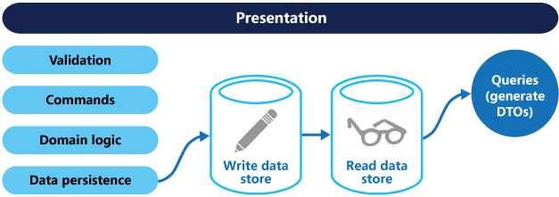
CQRS pattern

Slide 133
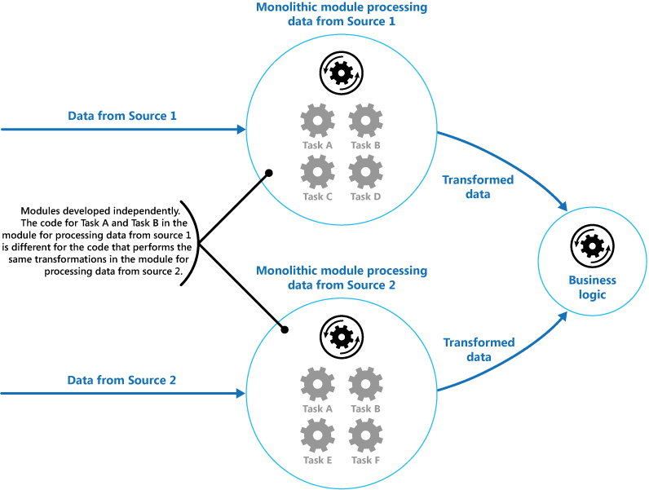
PIPEs and filters

Slide 134
Event Stream Processing select * from Withdrawal(amount>=200).win:length(5)

Slide 135
CQRS benefits
Fully encapsulated domain that only exposes behavior
Queries do not use the domain model
No object-relational impedance mismatch
Bullet-proof auditing and historical tracing
Easy integration with external systems
Performance and Scalability

Slide 136
Event Stream Processing products
Esper (open source)
StreamBase
RuleCast
Kafka

Slide 137
Messaging
Publish-Subscribe
Point-to-Point
Store-forward
Request-Reply

Slide 138
Publish-Subscribe
Receiver
topic
Sender
Receiver
Receiver

Slide 139
Point-to-point
topic
Sender
Receiver

Slide 140
Store-forward
Durability, event log, auditing etc
Sender
Mediator
Receiver
storage

Slide 141
Request-Reply
F.e. AMQP’s ‘replyTo’ header
request
request
Sender
queue
Receiver
reply
reply

Slide 142
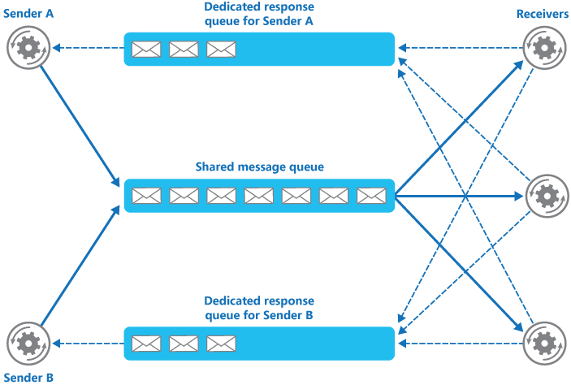
Shared Message Queue

Slide 143
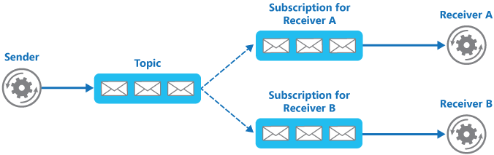
Sender and Subscriber

Slide 144
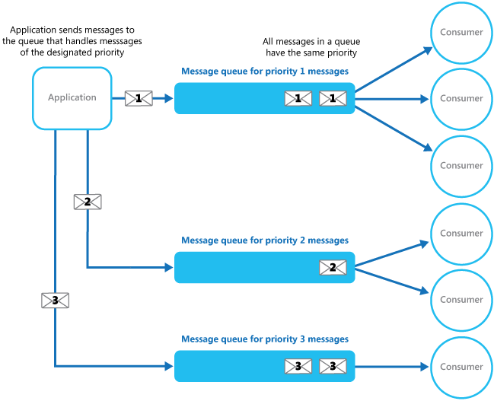
Priority Queue

Slide 145
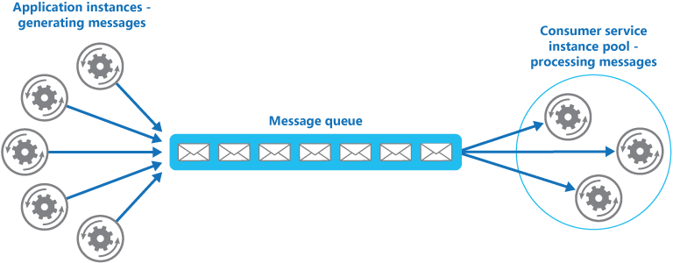
Competing Consumer

Slide 146
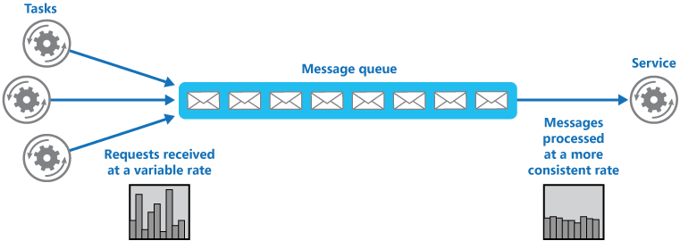
Queue Based Load Leveling Pattern

Slide 147
Messaging, push or pull?
Only a few subscriber, push is better (< 100)
Many subscriber, pull is better.

Slide 148
Messaging
Stands
AMQP
JMS
Products
RabbitMQ (AMQP)
ActiveMQ (JMS)
Tibco
MQSeries
etc

Slide 149
ESB

Slide 150
ESB Products
ServiceMix (open source)
Mule (open source)
Open ESB (open source)
Sonic ESB
WebSphere ESB
Oracle ESB
Tibco
BizTalk Server

Slide 151
Actors
Fire-forget
Async send
Fire and Receive Eventually
Async send + wait on future for reply

Slide 152
Enterprise Integration Patterns

Slide 153
Enterprise Integration Patterns
Apache Camel
More than 80 endpoints
XML (Spring) DSL
Scala DSL

Slide 154
Compute Grids

Slide 155
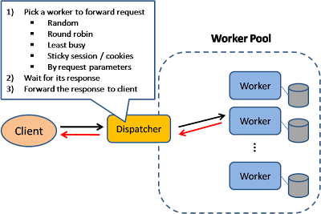
Load Balancer
In this model, there is a dispatcher that determines which worker instance will handle the request based on different policies. The application should best be "stateless" so any worker instance can handle the request.

Slide 156
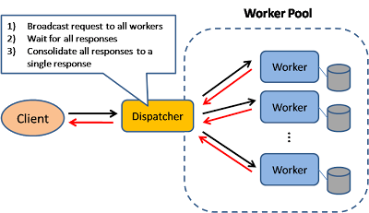
Scatter and Gather
In this model, the dispatcher multicast the request to all workers of the pool. Each worker will compute a local result and send it back to the dispatcher, who will consolidate them into a single response and then send back to the client. This pattern is used in Search engines like Yahoo, Google to handle user's keyword search request ... etc.

Slide 157
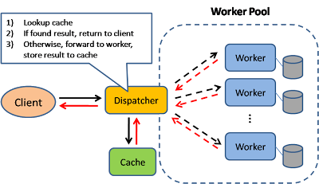
Result Cache
In this model, the dispatcher will first lookup if the request has been made before and try to find the previous result to return, in order to save the actual execution. This pattern is commonly used in large enterprise application. Memcached is a very commonly deployed cache server.

Slide 158
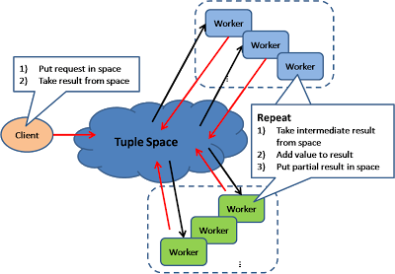
Shared Space
This model also known as "Blackboard"; all workers monitors information from the shared space and contributes partial knowledge back to the blackboard. The information is continuously enriched until a solution is reached. The objects in the shared space may have states, the worker may process the object when the state is satisfactory and set the state for the next step

Slide 159
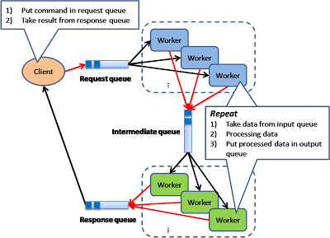
Pipe and Filter
This model is also known as "Data Flow Programming"; all workers connected by pipes where data is flow across. This pattern is a very common EAI pattern.

Slide 160
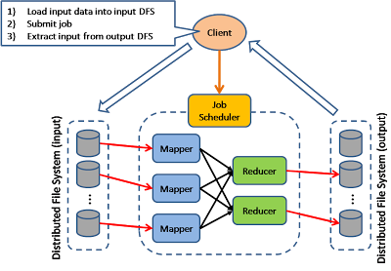
Map Reduce
The model is targeting batch jobs where disk I/O is the major bottleneck. It use a distributed file system so that disk I/O can be done in parallel. This pattern is used in many of Google's internal application, as well as implemented in open source Hadoop parallel processing framework. I also find this pattern can be used in many many application design scenarios.

Slide 161
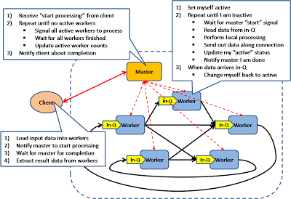
Bulk Synchronous parallel
This model is based on lock-step execution across all workers, coordinated by a master. Each worker repeat the following steps until the exit condition is reached, when there is no more active workers. 1. Each worker read data from input queue 2. Each worker perform local processing based on the read data
3. Each worker push local result along its direct connection
This pattern has been used in Google's Pregel graph processing model as well as the Apache Hama project.

Slide 162
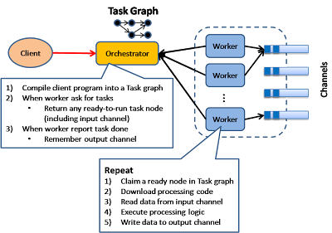
Execution Orchestrator
This model is based on an intelligent scheduler / orchestrator to schedule ready-to-run tasks (based on a dependency graph) across a clusters of dumb workers. This pattern is used in Microsoft's Dryad project

Slide 163
Compute Grids Parallel execution
Divide and conquer
Split up job in independent tasks
Execute tasks in parallel
Aggregate and return result
MapReduce - Master / Worker
Automatic provisioning
Load Balancing
Failover
Topology resolution

Slide 164
Compute Grids products
Platform
Data Synapse
Google MapReduce
Hadoop
Giga Spaces
Grid Gain

Slide 165
Load Balancing
Random Allocation
Round robin allocation
Weighted allocation
Dynamic load balancing
Least connections
Least server CPU
etc.
DNS Round Robin (simplest)
Ask DNS for IP for host
Get a new IP every time
Reverse Proxy (better)
Hardware Load Balancing

Slide 166
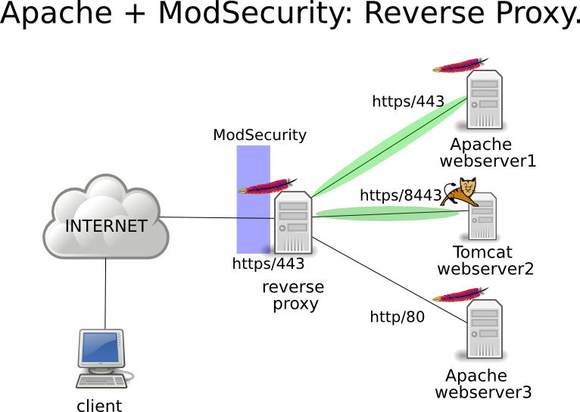
Reverse Proxy

Slide 167
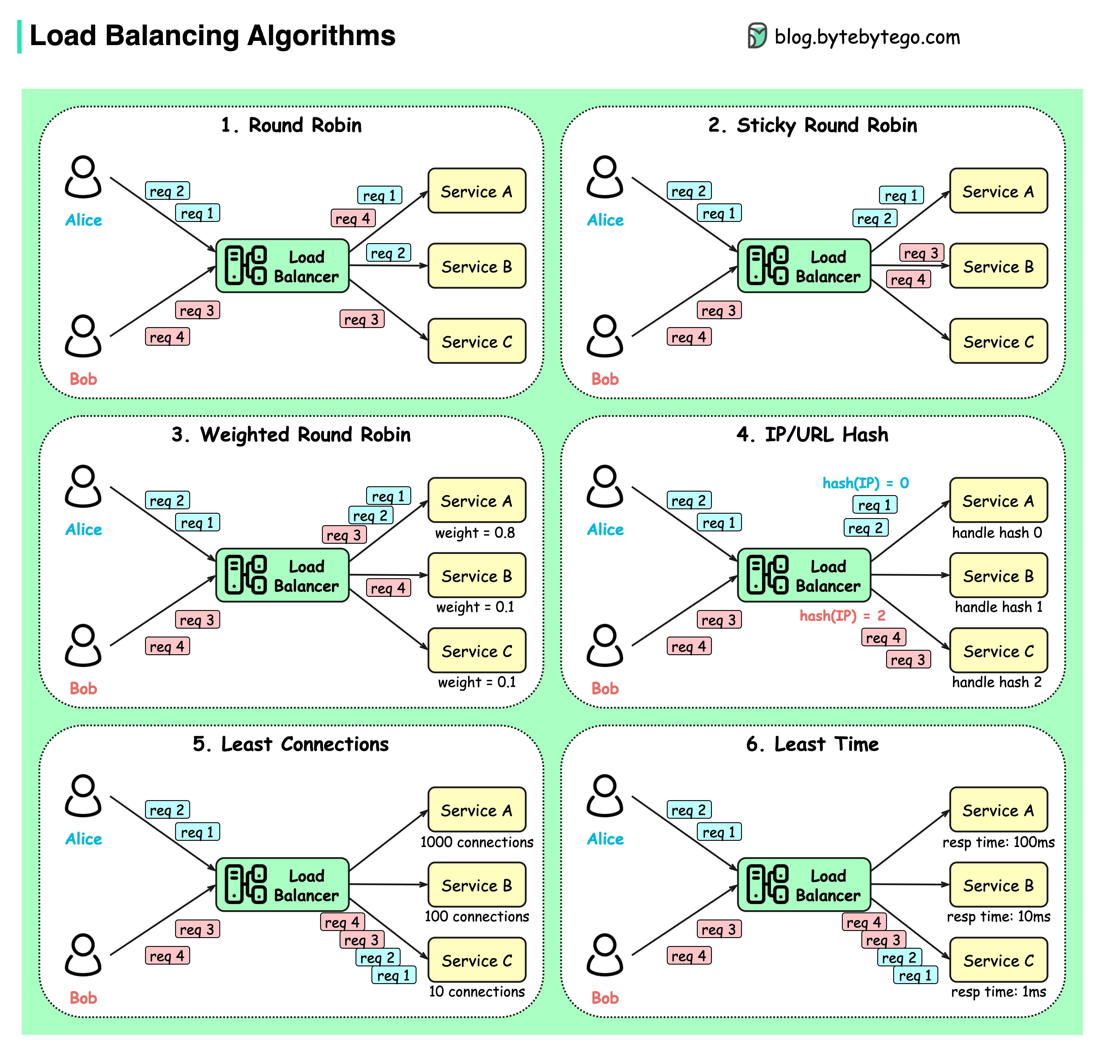

Slide 168
Load Balancing Products
Reverse Proxies:
Apache mod_proxy (OSS)
HAProxy (OSS)
Squid (OSS)
Nginx (OSS)
Hardware Load Balancers:
BIG-IP
CISCO

Slide 169
Parallel computing

Slide 170
Parallel Computing
SPMD Pattern
Master/Worker Pattern
Loop Parallelism Pattern
Fork/Join Pattern
MapReduce Pattern
UE: Unit of Execution
Process
Thread
Coroutine
Actor

Slide 171
SPMD Pattern
Single Program Multiple Data
Very generic pattern, used in many other patterns
Use a single program for all the Ues
Use the UE’s ID to select different pathways through the program. e.g.
Branching on ID
Use ID in loop index to split loops
Keep interactions between UEs explicit

Slide 172
Master /Worker

Slide 173
Master / Worker
Good scalability
Automatic load balance
How to detect termination
Bag of task is empty
Poison pill
If we bottleneck on single queue
Use multiple work queues
Work steal
What about fault tolerance?
Use “in-progress” queue
Use timeout and retry task (idempotent)
Use database table is a simple implementation.

Slide 174
Loop Parallelism
Workflow
Find the loops that are bottlenecks
Eliminate coupling between loop interactions
Parallelize the loop
If too few interactions to pull its weight
Merge loops
Coalesce nested loops
OpenMP
omp parallel for
What if task creation can’t be handled by:
Parallelizing loops (Loop Parallelism)
Put them on work queues (Master / Worker)
Enter Fork / Join

Slide 175
Fork/Join
Java 7 ParallelArray (Fork / Join DSL)
ParallelArray students = new ParallelArray(fjPool, data);
double bestGpa = students.withFilter(isSenior).withMapping(selectGpa).max();

Slide 176
Map Reduce Products
Hadoop (OSS), used @ Yahoo
Amazon Elastic MapReduce
Many NOSQL DBs utilizes it for searching/querying

Slide 177
Map Reduce

Slide 178
Parallel Computing products
MPI
OpenMP
JSR166 Fork/Join
java.util.concurrent
ExecutorService, BlockingQueue etc.
ProActive Parallel Suite
CommonJ WorkManager (JEE)

Slide 179
Stability Patterns

Slide 180
Stability Patterns
Timeouts
Circuit Breaker
Let-it-crash
Fail fast
Bulkheads
Steady State
Throttling

Slide 181
Timeouts
Always use timeouts (if possible):
Thread.wait(timeout)
reentrantLock.tryLock
blockingQueue.poll(timeout,timeUnit)/offer(..)
futureTask.get(timeout,timeUnit)
socket.setSoTimeOut(timeout)
etc.

Slide 182
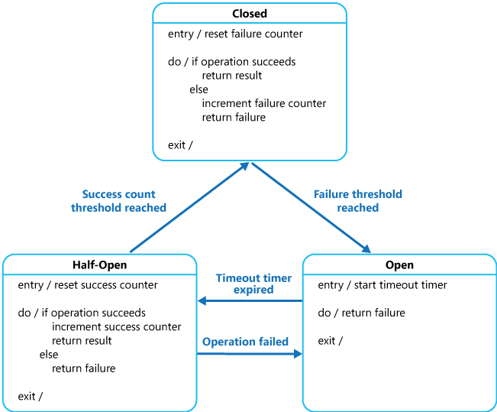
Circuit Breaker

Slide 183
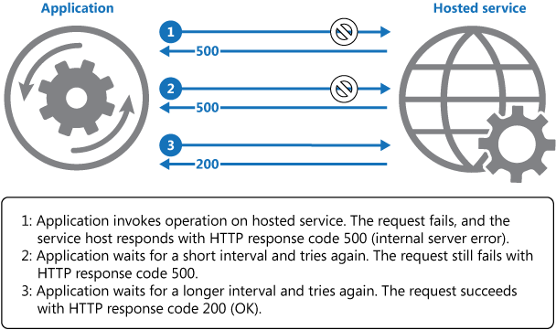
Retry pattern

Slide 184
Let it Crash
Embrace failure as a natural state in the life-cycle of the application
Instead of trying to prevent it; manage it
Process supervision
Supervisor hierarchies (from Erlang)
Restart by UD / FD

Slide 185
Fail fast
Avoid “slow responses”
Separate:
SystemError - resources not available
ApplicationError - bad user input etc
Verify resource availability before starting expensive task
Input validation immediately

Slide 186
Bulkhead

Slide 187
Bulkhead
Partition and tolerate failure in one part
Redundancy
Applies to threads as well:
One pool for admin tasks to be able to perform tasks even though all threads are blocked

Slide 188
Steady State
Clean up after you
Logging:
RollingFileAppender (log4j)
logrotate (Unix)
Scribe - server for aggregating streaming log data
Always put logs on separate disk

Slide 189
Throttling
Maintain a steady pace
Count requests
If limit reached, back-off (drop, raise error)
Queue requests
Used in for example Staged Event-Driven Architecture (SEDA)

Slide 190
DevOps Pattern

Slide 191
Operation pattern
Leader Election
External Configuration Store
Runtime Reconfiguration
Health Endpoint Monitoring
Scheduler Agent Supervisor
Telemetry

Slide 192
Leader Election
Node Signature
Bully Algorithm
Ring Algorithm
Acquire Mutex

Slide 193




Bully Algorithm

Slide 194




Bully Algorithm

Slide 195




Ring Algorithm

Slide 196




Ring Algorithm

Slide 197




Ring Algorithm

Slide 198

Acquire Mutex

Slide 199

External Configuration Store

Slide 200

Runtime Reconfiguration

Slide 201
Runtime Reconfiguration

Slide 202

Health Endpoint Monitoring

Slide 203

Scheduler Agent Supervisor

Slide 204
Telemetry and Metering
Data can be divided into three categories
Real time data
Ddelay in seconds, retention 24 hours
Service Data Store, monitoring and alerting
Short term data
Delay with 30 minutes, retention for one week.
Kusto, service diagnosis
Long term data
Daily data, retention for years
Cosmos, business analysis

Slide 205
Security Pattern

Slide 206
Security pattern
Federated Identity Pattern
Valet Key Pattern
Gatekeeper Pattern

Slide 207

Federated Identity

Slide 208

Federated Identity

Slide 209

Valet Key pattern

Slide 210

Gatekeeper

Slide 211
Common Cloud Scenario & Algorithm

Slide 212
Common Cloud Scenario & Algorithm
Recommender System
Facebook News Feed and Timeline
Tweeter snow flakes
Geo Hash
Bloom Filter

Slide 213

Paradigms of recommender systems
Personalized recommendations
Collaborative: "Tell me what's popular among my peers“
Content‐based: "Show me more of the same what I've liked“
Knowledge‐based: "Tell me what fits based on my needs"

Slide 214


Slide 215


Slide 216


Slide 217


Slide 218

Facebook news feed and Timeline

Slide 219

Tweeter

Slide 220

Twitter-Snowflake 64 bits mono-increasing unique id

Slide 221

Geo hash
Use binary divide the global geo location.
Smaller location have more bits.
Adjacent location has only 1 bit different.

Slide 222

Facebook Erlang
Entity: User, message, channel, friend list.
Public channel is almost like a news feed.
Monotonic read consistency.
SQL for user management and friend list
Non-SQL, such as Kafka for channel or messages.

Slide 223

Bloom Filter
Use multiple hash function to calculate the values of a string and generate a hash mask
Use the hash mask key to search the corresponding blocks.

Slide 224


